Slide 1


CO5
Analyze correctly and solve properly application problems concerning the derivatives to include writing equation of tangent/normal line, curve tracing ( including all types of algebraic curves and cusps), optimization problems, rate of change and related-rates problems (time-rate problems).

Slide 2

OBJECTIVE:
At the end of the lesson, the students should be able to illustrate properly and solve application problems involving the derivatives as an instantaneous rate of change or as slope of the tangent line.

Slide 3

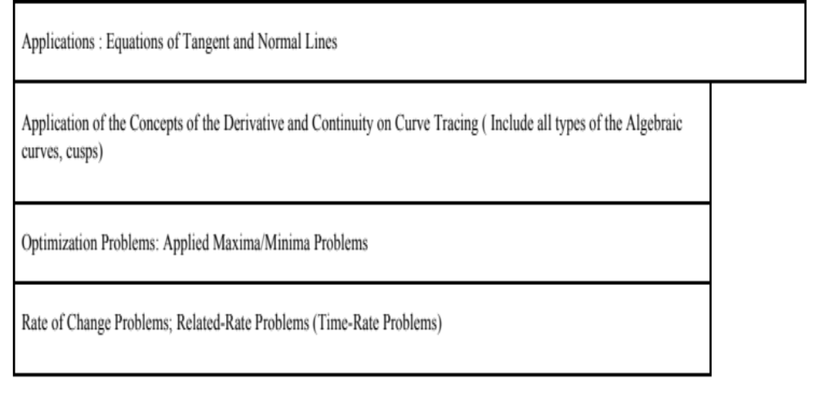
Long Quiz 4 Coverage

Slide 4
APPLICATIONS of the DERIVATIVES

Slide 5
Lesson 1 : SLOPE OF A CURVE, TANGENT Line, and NORMAL LINE

Slide 6

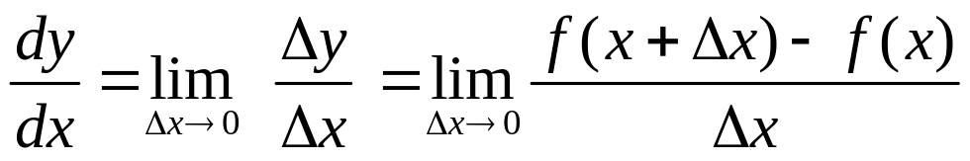
DEFINITION:
The derivative of at point P on the curve is
equal to the slope of the tangent line at P, thus the derivative of the function with respect to x at any x in its domain is defined as:
provided the limit exists.

Slide 7




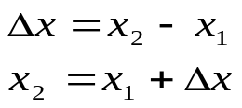
The derivative of a function is equal to the slope of the tangent line at any point along the curve.
y
tangent line
secant line
x

Slide 8
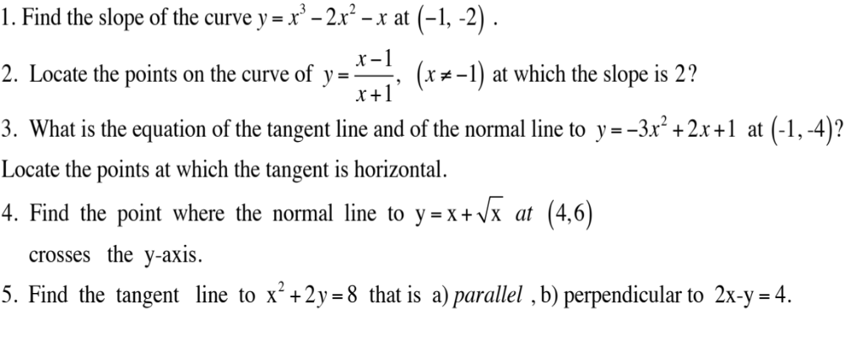
Sample Problems

Slide 9
Lesson 2: Calculus-based Analysis of Properties of Function; Graphs of Function

Slide 10
ANALYSIS OF FUNCTIONS :
INCREASING and DECREASING FUNCTIONS, ROLLE’S THEOREM, MEAN VALUE THEOREM, CONCAVITY , POINT OF INFLECTION , RELATIVE/ ABSOLUTE EXTREMA

Slide 11
INCREASING and DECREASING FUNCTIONS
The term increasing, decreasing, and constant are used to describe the behavior of a function as one travels left to right along its graph. An example is shown below.
increasing
decreasing
increasing
constant
0
2
4

Slide 12
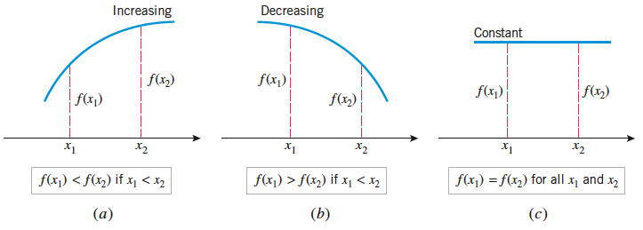
Geometrically:

Slide 13

y
y
x
x
Each tangent line
has positive slope;
function is increasing
y
Each tangent line
has negative slope;
function is decreasing
x
Each tangent line
has zero slope,
function is constant

Slide 14
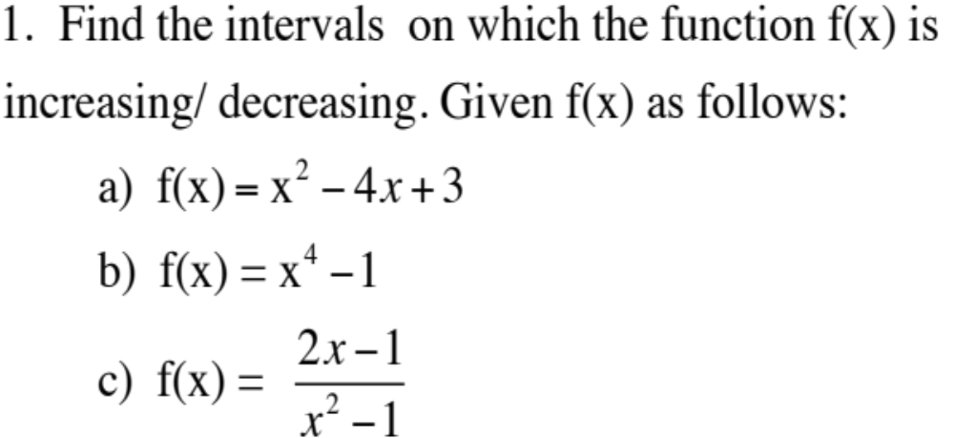
Sample Problems

Slide 15
ROLLE’S THEOREM
AND
THE MEAN-VALUE THEOREM

Slide 16

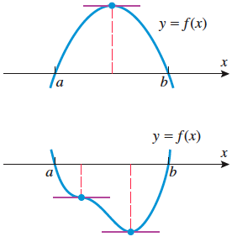
ROLLE’S THEOREM
Let f be continuous on a closed interval [ a, b ] and differentiable on the open interval ( a, b). If f(a) = 0 and f( b ) = 0 then there is at least one value c such that .

Slide 17
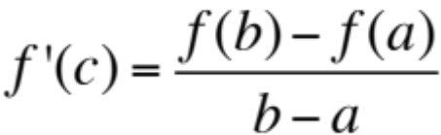
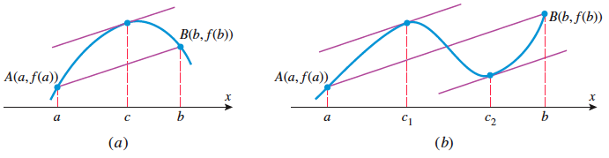
THE MEAN-VALUE THEOREM
Rolle’s Theorem is a special case of a more general result, called the Mean-value Theorem.
Let f be a continuous function on the closed interval [ a, b ] and is differentiable on the open interval ( a, b ). Then there is at least one value c such that
Figure 4.8.5

Slide 18

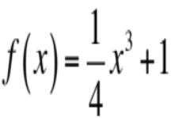
Sample Problems
1. Find the two x-intercepts of the function
and confirm that f’(c) = 0 at some point between those
intercepts.
2. Show that the function satisfies the hypotheses of the mean-value theorem over the interval [0,2], and find all values of c in the interval (0,2) at which the tangent line to the graph of f is parallel to the secant line joining the points (0,f(0)) and (2,f(2))

Slide 19
CONCAVITY, POINT of INFLECTION, RELATIVE/ABSOLUTE EXTREMA, GRAPHS

Slide 20
CONCAVITY
Although the sign of the derivative of f reveals where
the graph of f is increasing or decreasing , it does not
reveal the direction of the curvature.
There are two ways to characterize the concavity of a differentiable f on an open interval:
f is concave up on an open interval if its tangent lines have increasing slopes on that interval and is concave down if they have decreasing slopes.
f is concave up on an open interval if its graph lies above its tangent lines and concave down if it lies below its tangent lines.

Slide 21


y
Geometrically illustrated as follows:
y
concave up
concave down
x
increasing slopes
x
decreasing slopes

Slide 22
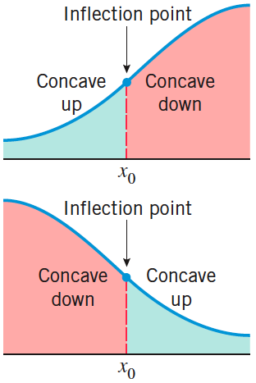
INFLECTION POINTS
Points where the curve changes from concave up
to concave down or vice-versa are called points of
inflection.

Slide 23
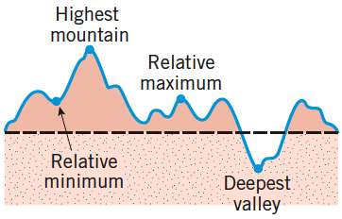
Definition: Maxima/Minima

Slide 24
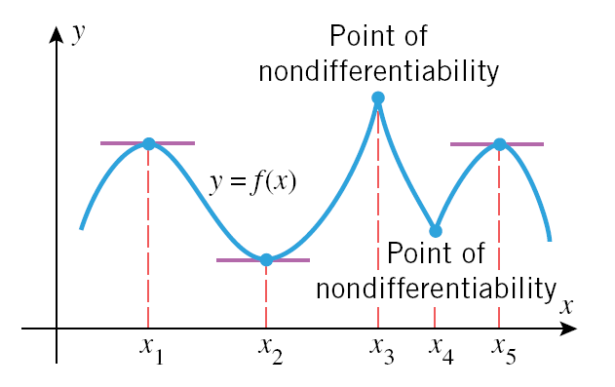
The points x₁, x₂, x₃, x₄, and x₅ are critical points. Of these, x₁, x₂, and x₅ are stationary points ( f’(x) = 0) and X₃ and x₄ are points of non-differentiability ( f’(x) is undefined or does not exist).

Slide 25
FIRST DERIVATIVE TEST FOR CRITICAL POINTS
A relative extremum may occur at critical points.
A function has a relative extremum at a critical points where f’(x) changes sign from left to right of the said point.
For a continuous function at a critical point x = c , a relative maximum occurs at x = c whenever the derivative changes from (+) to (–) going left to right of x = c . A relative minimum occurs at x = c whenever the derivative changes from (–) to (+).

Slide 26
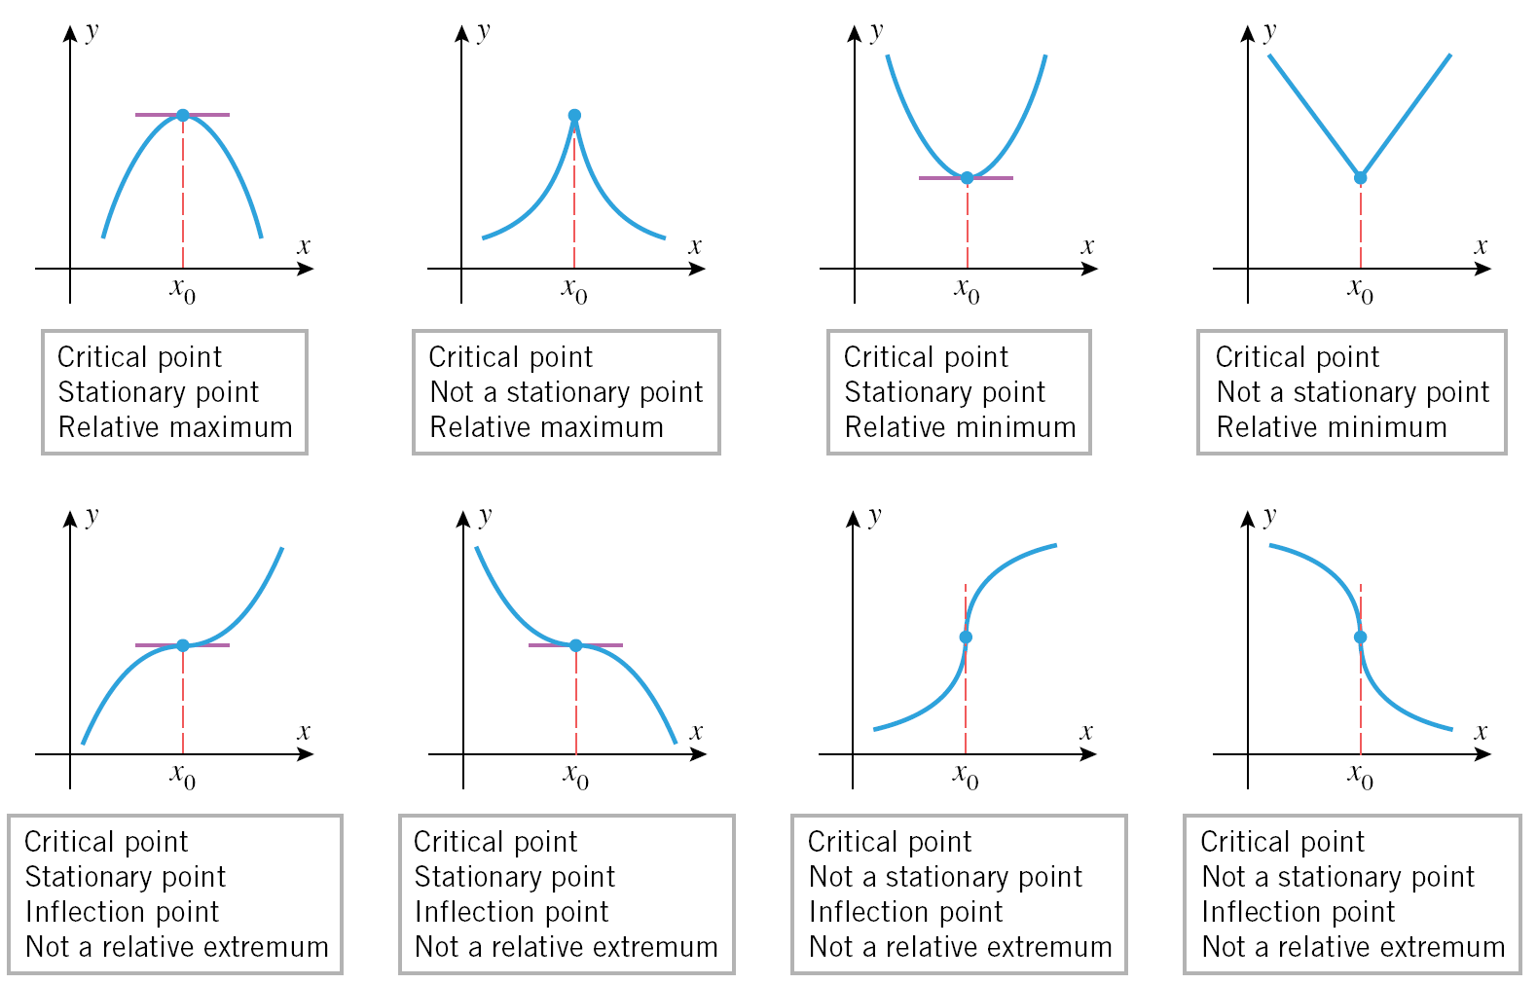

Slide 27
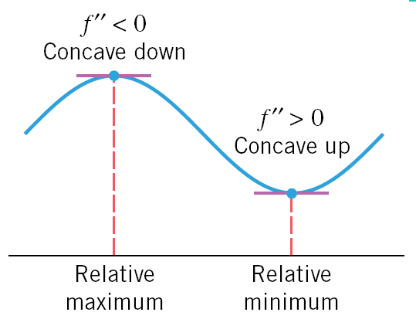
SECOND DERIVATIVE TEST
A function f has a relative maximum at stationary point if the graph of f is concave down on an open interval containing that point ( f”(x) <0).
A function f has a relative minimum at stationary point if the graph of f is concave up on an open interval containing that point ( f”(x) >0).

Slide 28
Steps in Curve Tracing
1. If the equation is given in the form of f( x, y) = 0, solve for y (or y²).
2. Subject the equation to the test of symmetry.
3. Determine the x and y intercepts.
4. Locate the critical points and determine the maxima/
minima.
5. Determine the asymptotes if any. Also determine the intersection of the curve with the horizontal asymptotes.
Note: The curve may intercept the horizontal asymptotes but not the vertical asymptotes.

Slide 29
6. Divide the plane into regions by drawing light vertical lines through the intersection on the x-axis.
Note: All vertical asymptotes must be considered as dividing lines.
7. Find the sign of y on each region using the factored form of the equation to determine whether the curve lies above and/or below the x-axis.
8. Trace the curve. Plot a few points if necessary.

Slide 30
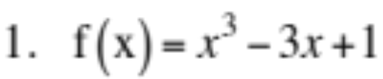
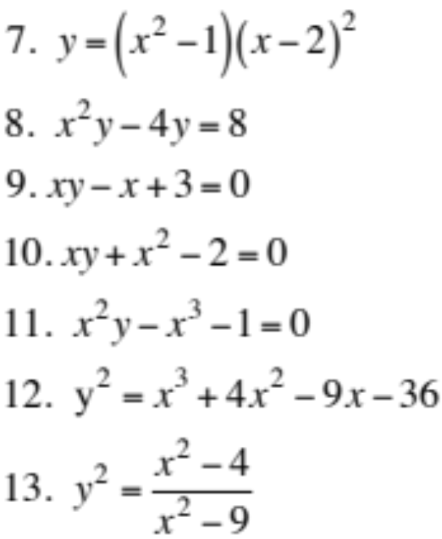
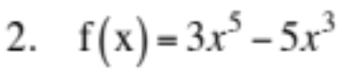
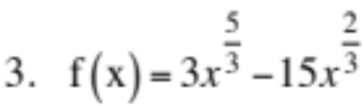


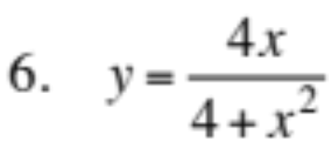
SAMPLE PROBLEMS
Work-out a Calculus-based analysis of properties then sketch the graph of y = f(x):

Slide 31
MAXIMA and MINIMA PROBLEMS

Slide 32
Steps in solving maximum and minimum problems.
Draw the figure and label accordingly. indicate the given parts and the unknown parts.
Make the necessary representation for the variables used.
Determine the quantity, the dependent variable, to be maximized or minimized.
Find a formula relating the variables.
If possible, express the dependent variable in terms of a single independent variable.
Differentiate the dependent variable in terms of the independent variable.
Determine the critical values.
Answer the problem completely.

Slide 33
SAMPLE PROBLEMS:
1. Divide 120 into two parts such that the product of one part and the square of the other is a maximum. Find the numbers.
2. A box is to be made from a piece of cardboard 16in.x10in. by cutting equal squares out of the corners and turning up the sides. Find the volume of the largest box that can be made this way.

Slide 34
3. Find the area of the largest rectangle that can be inscribed in a circle of a given radius, R = 10 inches.
2x
R
R
y
2y
x

Slide 35
4. Find the altitude of the largest circular cylinder that can be inscribed in a circular cone of radius R=5” and height H=10”.
10-y
H=10”
y
x
R=5”

Slide 36
5. A rectangular field of fixed area is to be enclosed and divided into three lots by parallels to one of the sides. What would be the relative dimensions of the field to make the amount of fencing a minimum?
W
L

Slide 37
6. Find the most economical proportions for a quart can.
r
h
d

Slide 38
7. Find the proportion of the circular cylinder of largest volume that can be inscribed in a given sphere.
r
r
a
a
h/2
h
2a
C

Slide 39
ADDITIONAL SAMPLE PROBLEMS:
What number exceeds its square by the maximum amount?
The sum of two numbers is “K”. find the minimum value of
the sum of their squares.
A rectangular field of given area is to be fenced off along the bank of a river. If no fence is needed along the river, what are the dimensions of the rectangle that will require the least amount of fencing?
A Norman window consists of a rectangle surmounted by a semicircle. What shape gives the most light for a given perimeter?
A cylindrical glass jar has a plastic top. If the plastic is half as
expensive as the glass per unit area, find the most economical proportions for the glass.
Find the proportions of the circular cone of maximum volume
inscribed in a sphere.
A wall 8 feet high and 24.5 feet from a house. Find the shortest
ladder which will reach from the ground to the house when
leaning over the wall .

Slide 40
TIME RATES PROBLEMS

Slide 41
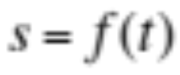
If a particle is moving along a straight line according to the equation of motion , since the velocity may be interpreted as a rate of change of distance with respect to time, thus we have shown that the velocity of the particle at time “t” is the derivative of “s” with respect to “t”.
There are many problems in which we are concerned with the rate of change of two or more related variables with respect to time, in which it is not necessary to express each of these variables directly as function of time. For example, we are given an equation involving the variables x and y, and that both x and y are functions of the third variable t, where t denotes time.

Slide 42


Since the rate of change of x and y with respect to t is given by and , respectively, we differentiate both sides of the given equation with respect to t by applying the chain rule.
When two or more variables, all functions of t, are related by an equation, the relation between their rates of change may be obtained by differentiating the equation with respect to t.

Slide 43
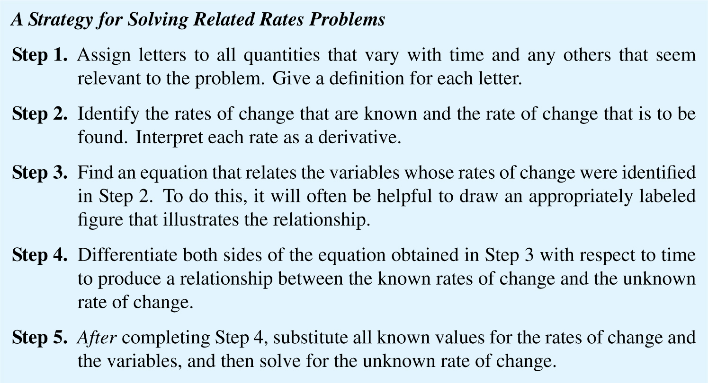

Slide 44
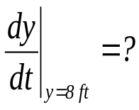
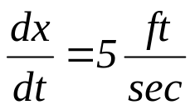
Example 1
A 17 ft ladder is leaning against a wall. If the bottom of the ladder is pulled along the ground away from the wall at the constant rate of 5 ft/sec, how fast will the top of the ladder be moving down the wall when it is 8 ft above the ground?
17 ft.
y
x

Slide 45
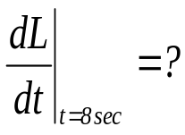
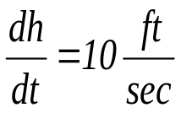
Example 2
A balloon leaving the ground 60 feet from an observer, rises vertically at the rate 10 ft/sec . How fast is the balloon receding from the observer after 8 seconds?
h
L
Viewer
60 feet

Slide 46

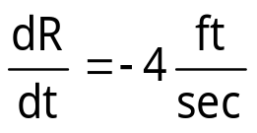

Example3
A man on a wharf of 20 feet above the water pulls in a rope, to which a boat is attached, at the rate of 4 ft/sec. At what rate is the boat approaching the wharf when there is 25 feet of rope out?
R
20ft
x

Slide 47
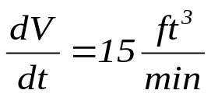
Example 4
Water is flowing into a conical reservoir 20 feet deep and 10 feet across the top, at the rate of 15 ft³/min . Find how fast the surface is rising when the water is 8 feet deep?
10 feet
5 feet
r
20 feet
h

Slide 48
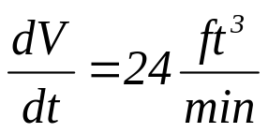
Example 5
Water is flowing into a vertical tank at the rate of 24 ft³/min . If the radius of the tank is 4 feet, how fast is the surface rising?
4 feet
h

Slide 49
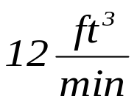
Example 6
A triangular trough is 10 feet long, 6 feet across the top, and 3 feet deep. If water flows in at the rate of 12 ft³/min, find how fast the surface is rising when the water is 6 inches deep?
6 feet
x
3 feet
h
10 feet

Slide 50
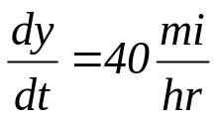
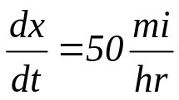
Example 7
A train, starting at noon, travels at 40 mph going north. Another train, starting from the same point at 2:00 pm travels east at 50 mph . Find how fast the two trains are separating at 3:00 pm.
C
3pm
y
B
2pm
L
80 miles
A
12pm
3pm
2pm
D
x

